Slide 1


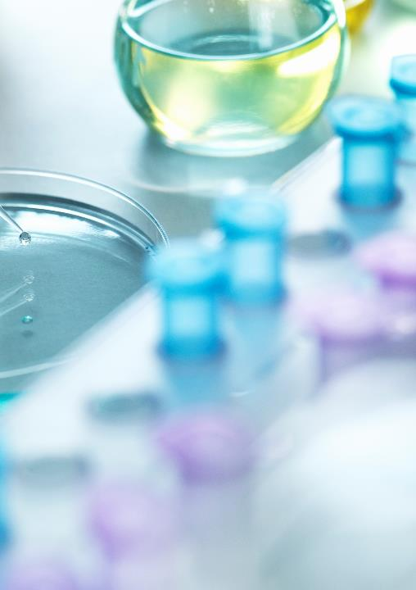
MACHINE LEARNING LAB
TEAM 28 : PUNNETH RANJAN -121CS0213 BODDEDA NEHITHA RATAHN- 121CS0215 SAMBIT KUMAR ROUT-121CS0216
SUBMITTED TO : RATNAKAR DASH

Slide 2
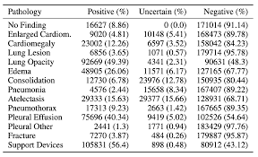
. Disease Diagnosis from Chest X-rays using Transfer Learning
INTRODUCTION
DATASET OVERVIEW
DATASET PREPROCESSING
PROPOSED METHODOLOGY
RESULTS.
CONCLUSION
GUI DEVELOPMENT
REFERENCE

Slide 3
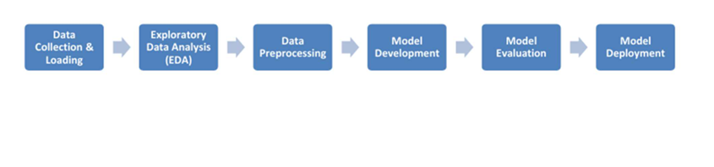
Model

Slide 4

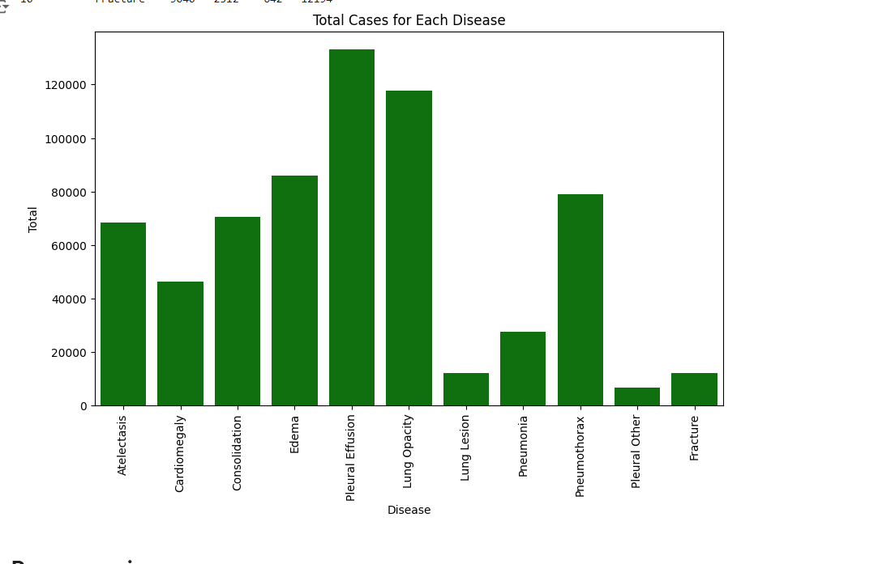
DATA PREPROSSESING
1: Indicates the presence of the disease.
0: Indicates the absence of the disease.
-1: Represents uncertainty, where it is unclear if the disease is present or absent.

Slide 5
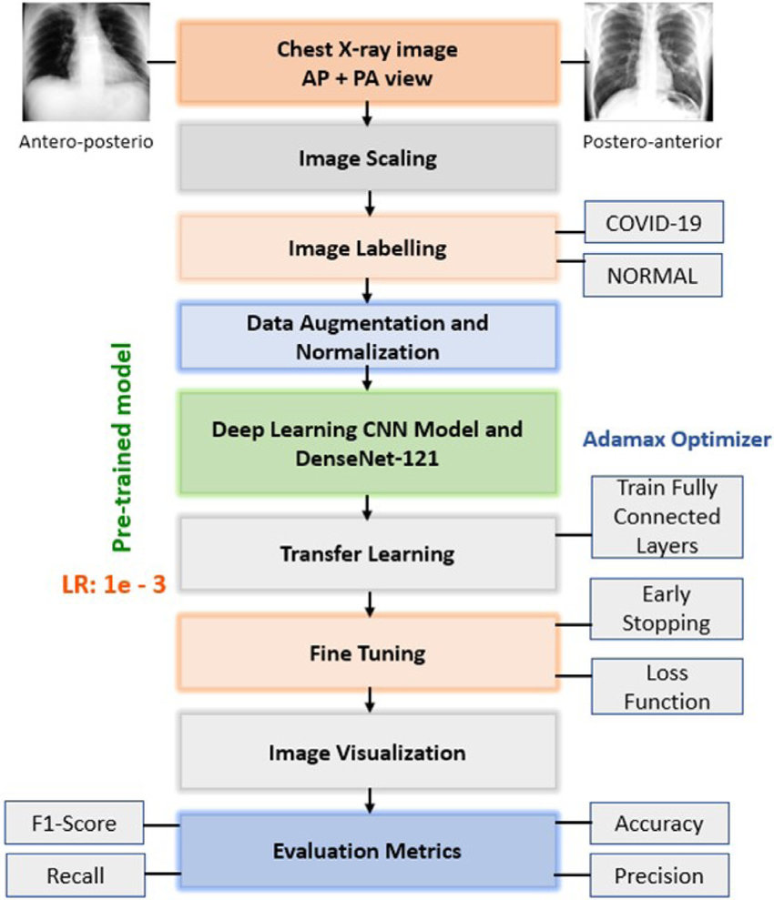
TRANSFER LEARNING DENSENET 121

Slide 6

RESULTS

Slide 7

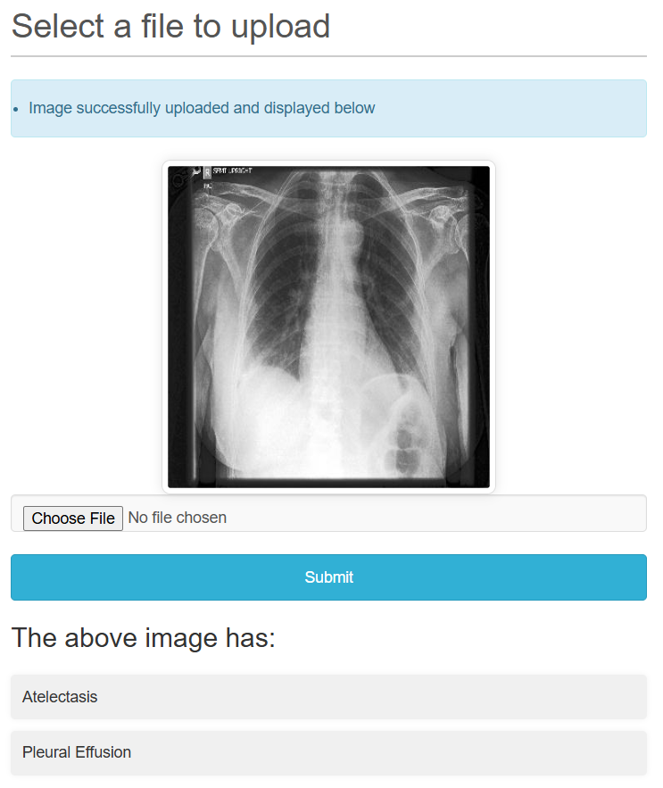
GUI

Slide 8
THANKYOU

